Slide 1
Impairment Issues & The ARDC: Avoiding Disciplinary Problems ____________________________________________________________________________________________________________________________
Stephanie L. Stewart
T - 312.763.6225 (Direct)
Email: sstewart@meyerlex.com

Slide 2
A Look at Statistics: Where do the Problems Arise? _____________________________________________________________________________________________________________________________________________________________
Disciplinary Complaints
ARDC Annual Report 2015
There were 5,648 investigations and 125 lawyers were sanctioned.

Slide 3
Impact of Substance Abuse/Mental Health Issues
___________________________________________________________________
27% of all sanctioned lawyers had one or more identified substance abuse or mental impairment issue

Slide 4
Impairments Identified for Lawyers Disciplined in 2015, by Practice Setting

Slide 5
Nature of the Complaint
__________________________________________________________________________________
54% of all grievances involve issues of poor attorney-client relations, neglect of a client matter (39%), or failure to communicate with a client (15%).

Slide 6
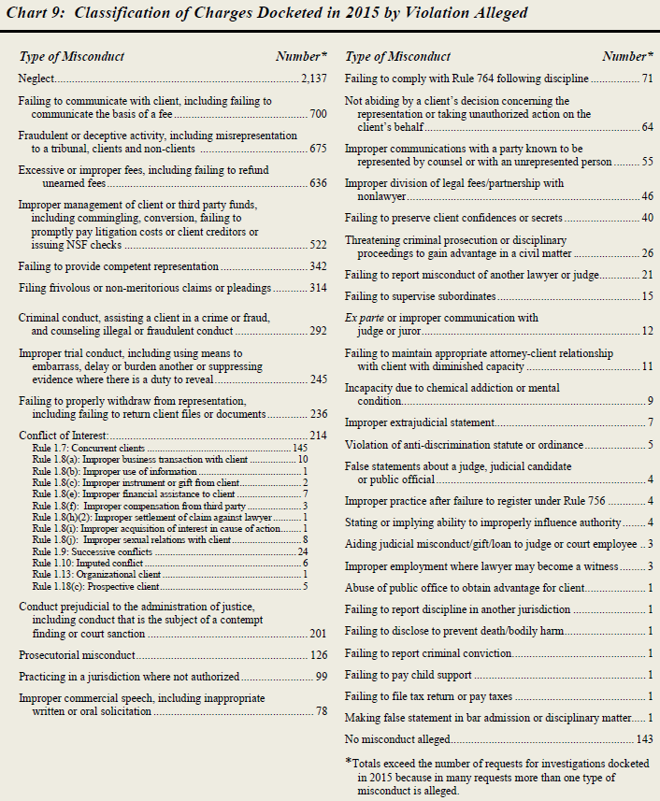
Classification of Charges Docketed in 2015 by Violation Alleged

Slide 7
The Most Common Legal Malpractice Claims by Type of Alleged Error
Fail to Know/Apply Law 11.3%
Planning Error 8.9%
Inad Disc/Investigation 8.8%
Fail to File Documents 8.6%
Fail to Calendar 6.7%
Fail to Know Deadline 6.6%
Procrastination 5.9%
Fail to Obtain Client Consent 5.4%
Conflict of Interest 5.3%
Fraud 5.0%
Fail to Follow Instructions 4.4%
Fail to React to Calendar 3.8%

Slide 8
The Proactive Law Firm: Checks & Balances __________________________________
1. Lawyers do not make their own calendar entries
2. Lawyers do not open their own mail
3. Weekly meetings that are prospective and retrospective
4. Administrative staff required to report case/client issues
5. Communication, communication, communication!

